Slide 1
Masked Face Recognition System
Final Presentation

Slide 2
Cost Estimation
Hardware Part | Version | Piece | Price
Microcontroller | Arduino UNO R3 Kit | 1 | 880 TL
Microchip ports Extenders | 74HC595 | 2 | 5.25 TL
Ethernet Port | ENC25J60 | 1 | 107.5 TL
LCD Screen | 1.8inch | 1 | 219 TL
Power Cable | GePro UM-85 | 1 | 34.2 TL
Red Led | Red Led Package | 1 | 3.5 TL
NFC Keychain | 13.56 MHz | 2 | 4.55 TL
RFID Card | 125 kHz | 2 | 4.55 TL
Breadboard | Normal | 3 | 21 TL
Battery | 9V | 1 | 9.45 TL
Ticket NFC | 13.56 MHz | 5 | 4.2 TL

Slide 3
Cont.
Hardware Part | Version | Piece | Price
Jumper Cable Kit | M-M | 2 | 19 TL
RFID Reader | RC522 | 1 | 31 TL
Green Led | Green Led Package | 1 | 3.5 TL
Resistors | Resistors Kit | 1 | 56.33 TL
Temperature Sensor | DH11 | 1 | 31.3 TL
Welding Gun | ZD 23 30W | 1 | 103 TL
Gas Sensor | MQ-2 | 1 | 28.4 TL
Double Faced Pertinax | 7*9 cm & 8*12 cm | 1 | 33 TL
Camera | ESP32-CAM | 1 | 157.5 TL
Soldering Tin | 1.60 mm 100 g | 1 | 75.7 TL
Multimeter | Marxlow DT-830D | 1 | 51 TL
Total cost : 1880 TL

Slide 4
Project Performance
Cost: In the cost estimation was 1880TL but in face the project costs us 2127TL
Time: The project was done on the time without any changes

Slide 5
Duration Estimate
Task | Time (days)
Order the hardware parts from Turkey | 7– 15
Hardware Connecting | 5
RFID coding | 1
Face recognition coding | 3
Masked Face Recognition | 4
Database creation | 2
Testing the hardware & software | 2
Testing the system in many scenarios | 5
EVMC Smart Contract coding | 3
EVMC Smart Contract Testing | 2
Chainlink to Kadena bridge | 2
Testing the smart contract on the mainnet | 2
Total days | 39 - 46

Slide 6
Reporting Requirements
Report | Format | Frequency | Source
Work progress | Each member will be responsible to send weakly report of what each team member did in this week | Weakly | AZFCO.
Software quality test | Unit testing Control flow testing Dataflow testing Domain testing System integration testing System functional test | After finishing the software work. After finishing the system at all. | AZFCO.
Hardware quality test | Hardware working status Hardware connection status | After finishing the hardware work. After finishing the system at all. | AZFCO.
Smart Contract auditing | Audit Summary Vulnerability Summary Audit Scope | After finishing the smart contract. After finishing the system at all. | CertiK

Slide 7
Activity List
Identifier | Name | Description
1 | Determining the idea | Determine the general idea of the project
2 | Research | We need to search in books, scientific research and articles on previous similar projects to understand the working mechanism of the system.
3 | System Analyzing | After understanding the working mechanism of the system, we will identify all the strengths and weaknesses of each work mechanism and try to integrate work mechanisms to raise the strengths and reduce weaknesses.
4 | Order Hardware Parts | Determine the seller from whom we will buy the parts then order the hardware parts.
5 | Database creation | Create database contains all of the authenticated user’s information such as their faces, masked faces, RF cards, etc...
6 | RFID Hardware | Connect the RFID hardware parts.
7 | RFID Programming | Coding the RFID reader and connect it with the dataset.

Slide 8
Cont.
8 | RFID Testing | Testing the RFID system after coding and make sure only authenticated users are able to use the system
11 | Masked Face Recognition Programming | Coding the masked face recognition side and connect it with the dataset.
12 | Masked Face Recognition Testing | Testing the masked face recognition side to make sure it’s working correctly and the possibility of wrong identification is under the specification.
13 | Testing the hardware & software | Testing the system at all, hardware testing and software testing.
16 | Kadena smart contract programming | Coding the smart contract on KADENA Blockchain that will be used to validate the identity of users.
17 | Kadena smart contract testing | Testing the smart contract and send it to a specialized auditing company (Certik) to ensure that there are no errors that allow the smart contract to be hacked
18 | System test with smart contract | Testing the system at all with the smart contract and the consensus protocol
19 | Deployment | Deployment

Slide 9
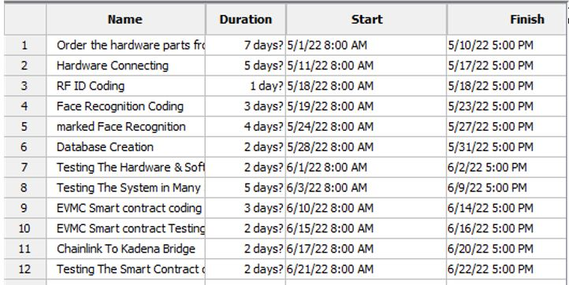
Gant Chart

Slide 10
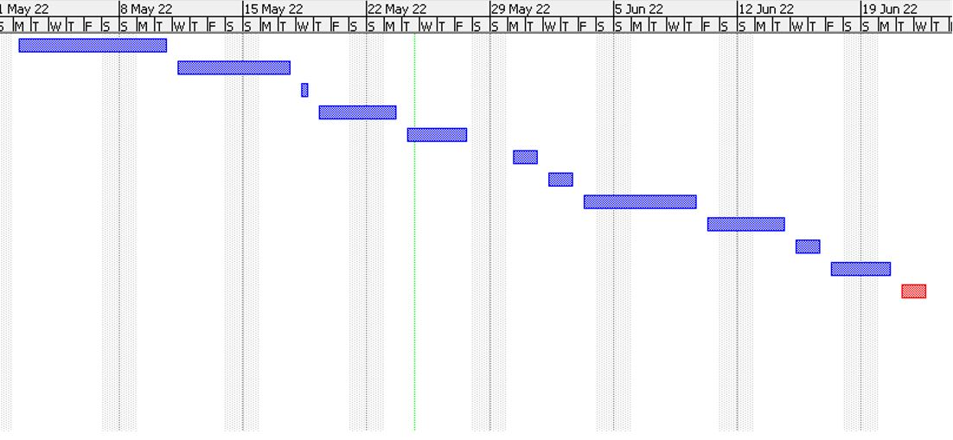
Cont.

Slide 11
Implementation
According to out activity duration estimate we need 39-46 days to deliver the system, our team is well trained so starting work on the project will be done directly after signing the contract, the activity duration estimate is described as following
Task | Time (days)
Order the hardware parts from Turkey | 7– 15
Hardware Connecting | 2
RFID coding | 1
Face recognition coding | 4
Masked Face Recognition | 6
Database creation | 2
Testing the hardware & software | 2
Testing the system in many scenarios | 5
EVMC Smart Contract coding | 3
EVMC Smart Contract Testing | 2
Chainlink to Kadena bridge | 2
Testing the smart contract on the mainnet | 2
Total days | 39 - 46

Slide 12
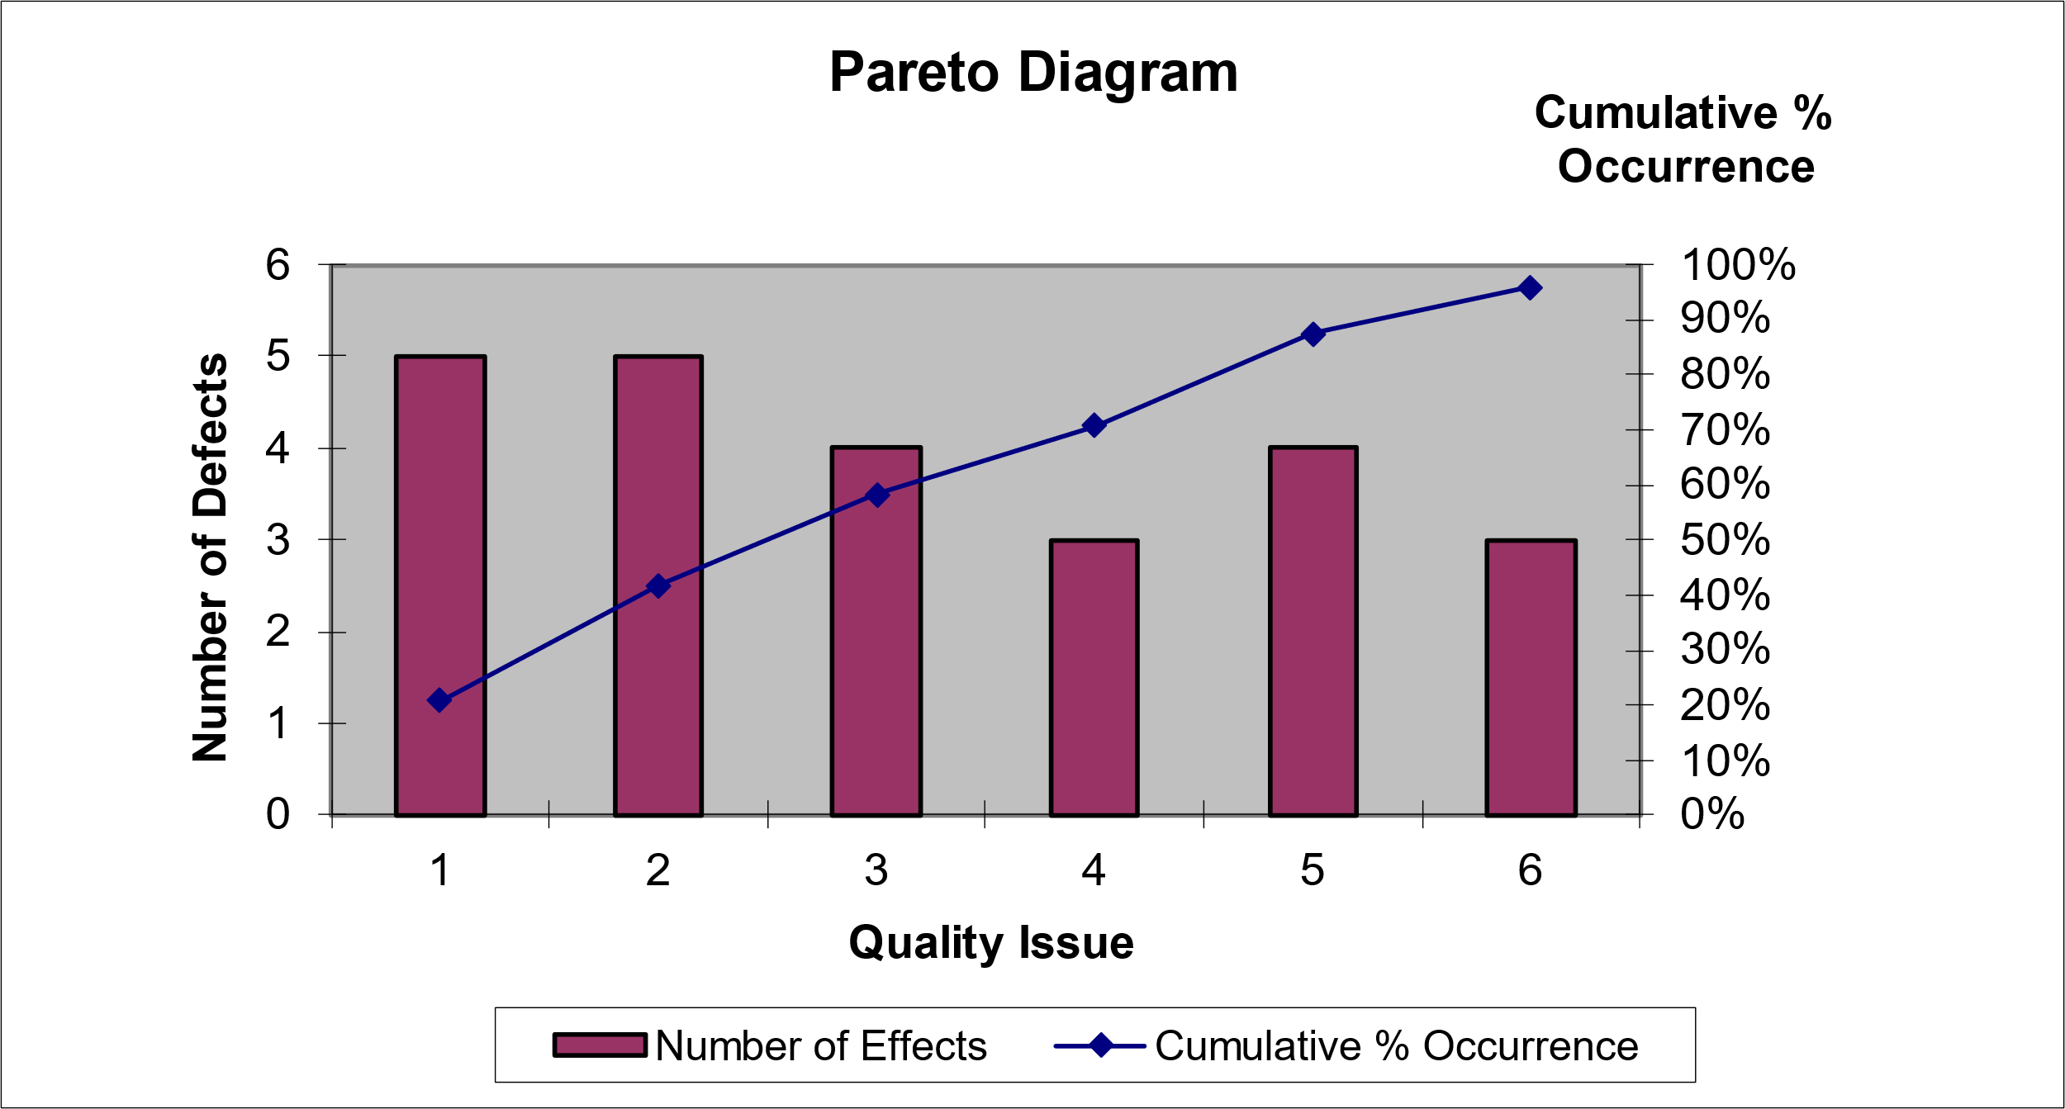
Pareto Diagram
Quality Issue | 1 | 2 | 3 | 4 | 5 | 6 | Total
Number of Defects | 5 | 5 | 4 | 3 | 4 | 3 | 24
% Occurrence | 20.83% | 20.83% | 16.67% | 12.50% | 16.67% | 12.50% | 100%
Cumulative % Occurrence | 20.83% | 41.67% | 58.33% | 70.83% | 87.50% | 95.83%

Slide 13
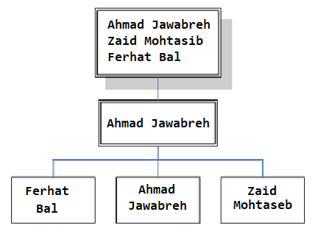
Project Organization
Name | Role | Phone Number | Email Address
Ahmad Jawabreh | Project Manager Hardware Specialist Smart Contract Developer | +972592675704 | Ahmadjawabreh@protonmail.com
Zaid Mohtasib | Software Engineer | +97256937208 | Zaidmoh@protonmail.com
Ferhat Bal | QA Specialist | +905338817935 | ferhatbal@protonmail.com

Slide 14
Approved Changes
One of the team members left the team, the tasks assigned to each team member were restructured by dividing the tasks of the member who left on the rest of the team members to complete the project within the specified time.

Slide 15
Contract Conditions
The customer and the company will using simple smart contract designed and audited by trusted company (CertiK), the customer will pay the installments on the time directly to the smart contract, and after meeting the smart contract conditions the contract will convert the money directly to the company, If the company dose not meet the conditions the smart contract will return the money to the customer.

Slide 16
Information Accessibility
According to our company aims, there will be no centralize storing of the data all of our documentations and data will be storing using file chain protocol, which give us a protocol to use thousands of distributed nodes around the world to store our data encrypted and distributed.

Slide 17
Training Requirements
Hardware Team:
Bachelors Degree in Computer Engineering, Electrical and Electronic Engineering or a related technical discipline.
Extensive experience with Arduino, RaspberryPi and Microcontrollers.
Software Team :
Bachelors Degree in Software Engineering, Computer Science or a related technical discipline.
Extensive experience with Python.
Smart contract team:
Write well-documented, performant, clean, and re-usable Solidity code.
Familiar with EVM environments
Familiar with Pact and Plutus programming languages.

Slide 18
Contingency Plans
15% of the company’s net profits will be continuously deducted and placed in the company’s treasury to serve as the company’s reserve in case we face any financial problem that requires liquidity.

Slide 19
Quality Analysis
Since the start of the project, certain restrictions have been placed regarding the quality of the product so that the product is able to carry out its function with an error rate that does not exceed 10%.
Hardware parts have been carefully selected so that we have chosen original and high-quality parts to avoid errors in the system
The success rate of face recognition process is 95%, which is higher than the planned percentage.

Slide 20
Achievement of Project Objectives
Project objectives
Find a solution to recognize masked faces.
Find alternative authentication method based on touch less.
Decentralization of processing the data.
Project outputs:
Masked Face Recognition System.
Alternative authentication method, RFID system.
Blockchain connection to data transfer and validation

Slide 21
10.0 Project Archives
Hardware Maps
System Code
Smart contract code and design
Database design
Cause and effect diagram
Activity Cost Estimation
Business Case
Communication Matrix
Communication Plan
Contract Agreement
Contract Management
Control Chart
Corrective Actions List
Risk Breakdown Structure
Pareto Diagram
Resource Histogram
HR management plan
End Report
Project Research
Project Proposal
Work Breakdown Structure
Work Breakdown Structure
Activity List
Activity Resource Requirement
Activity Duration Estimation

